Slide 1


Felicia Dobbins
August 3, 2023

Slide 2

Outline
Executive Summary
Introduction
Methodology
Results
Conclusion
Appendix

Slide 3
Executive Summary
Data Analytics Methodologies Used:
Data collection using SpaceX API and Web Scraping,
EDA (Exploratory Data Analytics) including interactive visual analytics, dashboarding, and machine learning predictive analysis.
Summary of all results
Data was cleaned and found to be valuable for the project’s purposes.
Data Visualization was beneficial in providing a clear picture of launch sites relative to one another.

Slide 4

Introduction
In the age of space development, can the Company Space Y compete with Space X?
To do this, we need to estimate the cost of a launch by predicting if a launch will be successful.
To be successful, where are the best places to launch?

Slide 5

Section 1

Slide 6

Methodology
Executive Summary
Data collection methodology:
Use a get request to request data from SpaceX API
Perform Web Scraping
Perform data wrangling
Normalize the data to a Pandas dataframe
Extract useful features to a new dataframe
Perform exploratory data analysis (EDA) using visualization and SQL
Perform interactive visual analytics using Folium and Plotly Dash
Perform predictive analysis using classification models
How to build, tune, evaluate classification models

Slide 7

"https://api.spacexdata.com/v4/launches/past"
"https://api.spacexdata.com/v4/launches/past"
Data Collection
Data was collected by making a get request to SpaceX API (https://api.spacexdata.com/v4/launches/past)
Web Scraping was performed to collect any relevant data (https://en.wikipedia.org/w/index.php?title=List_of_Falcon_9_and_Falcon_Heavy_launches&oldid=1027686922)

Slide 8
Data Collection – SpaceX API
Request rocket launch data from SpaceX API with the SpaceX url using a get request.
1
Decode and normalize the .json file to a Pandas dataframe.
2
Combine all columns into a dictionary and create a new dataframe (Launch_data) of the dictionary.
3
Filter the data to only include Falcon 9 Booster Versions.
4
Replace null values in ‘PayloadMass’ column with the mean.
Data was obtained from SpaceX’s public API
Data was cleaned and parsed as shown in the chart.
Source code: https://github.com/felicia-dobbins/Data_Science_Capstone/blob/main/jupyter-labs-spacex-data-collection-api.ipynb

Slide 9
Data Collection - Scraping
Web Scraping was performed to collect more data about the Falcon 9 historical launch records.
The scraping process is shown on the right.
Source code: https://github.com/felicia-dobbins/Data_Science_Capstone/blob/main/jupyter-labs-webscraping.ipynb
Use a get request to get the data from the url
Parse the data using ‘BeautifulSoup’
Extract the columns and create the data frame

Slide 10
Data Wrangling
Some EDA was performed to get a clear picture of the data.
Data was processed to make further EDA possible.
Launch site and Orbit data was analyzed to identify mission outcomes using .value_counts()
Mission outcomes were classified into successful and unsuccessful categories
The successful and unsuccessful categories were reassigned binary values of 1 and 0, respectively and assigned to a new column named ‘Class’.
Source code: https://github.com/felicia-dobbins/Data_Science_Capstone/blob/main/IBM-DS0321EN-SkillsNetwork_labs_module_1_L3_labs-jupyter-spacex-data_wrangling_jupyterlite.jupyterlite.ipynb

Slide 11
EDA with Data Visualization
To show relationships between pairs of variables, or multiple variables, scatterplots and bar charts were used.
To show success rate, a line graph was used.
Source code: https://github.com/felicia-dobbins/Data_Science_Capstone/blob/main/IBM-DS0321EN-SkillsNetwork_labs_module_2_jupyter-labs-eda-dataviz.ipynb.jupyterlite%20(1).ipynb

Slide 12
EDA with SQL
SQL Queries:
Identify all distinct launch sites
Select 5 launch sites that begin with ‘CCA’
Find the sum of the payload mass by NASA and the average by F9 V1.1
Identify the date of the first successful landing
List the name of booster with success with ‘drone ship’ and a payload mass within a specific range.
List the total number of successful and failed missions
Identify the booster that have carried the maximum payload mass
Find and rank records that meet specific criteria between specific dates.
Source code:https://github.com/felicia-dobbins/Data_Science_Capstone/blob/main/EDA%20SQL.ipynb

Slide 13

Build an Interactive Map with Folium
Folium maps were used to analyze SpaceX launch locations
Markers are used to identify names of launch sites.
Highlighted areas are used to identify general launch areas where launches are likely to take place.
Marker clusters represent each historical launch.
Lines on the map are shown to indicate the distance to significant areas.
Source code: https://github.com/felicia-dobbins/Data_Science_Capstone/blob/main/Location%20Analysis%20with%20Folium.ipynb

Slide 14

Build a Dashboard with Plotly Dash
Dashboard Plots:
Pie chart that showed the percentage of successful launches for all sites or for one site at a time.
Scatterplot which showed the relationship between success rate and payload mass on a sliding scale.
Using the dashboard, I was able to isolate specific characteristics that may have an impact on landing success rate based on the data shown.
Source code: https://github.com/felicia-dobbins/Data_Science_Capstone/blob/main/spacex_dash_app%20(1).py

Slide 15
Types of tests used:
Predictive Analysis (Classification)
Predictive Analysis
Load the data frame and standardize the data
Split the data into training and testing sets using train_test_split
Choose your parameters and fit the training data to the test.
Use prediction and sore to check the accuracy of the test
Plot the confusion matrix and analyze the results.
Repeat the process with the next predictive. Test (adjust process for test)
Logistic Regression
Support Vector Machine (SVM)
K Nearest Neighbors (KNN)
Decision Trees
Source code: https://github.com/felicia-dobbins/Data_Science_Capstone/blob/main/SpaceX%20Machine%20Learning%20Prediction.ipynb

Slide 16
Results
Exploratory Data Analysis Results:
SpaceX conducts launches at 4 distinct launch sites, 3 of which are located on the east coast, one on the west coast of the continental United States.
The first successful “ground-pad” landing was achieved in 2018.
Nearly 100% of mission outcomes are successful.
Mission success does not equate to launch or land success as some failures are planned for training purposes.
The lowest success rate belongs to booster version 1.1.
While the highest success rate belongs to booster version B5 at 100% success rate (1 successful trial).

Slide 17
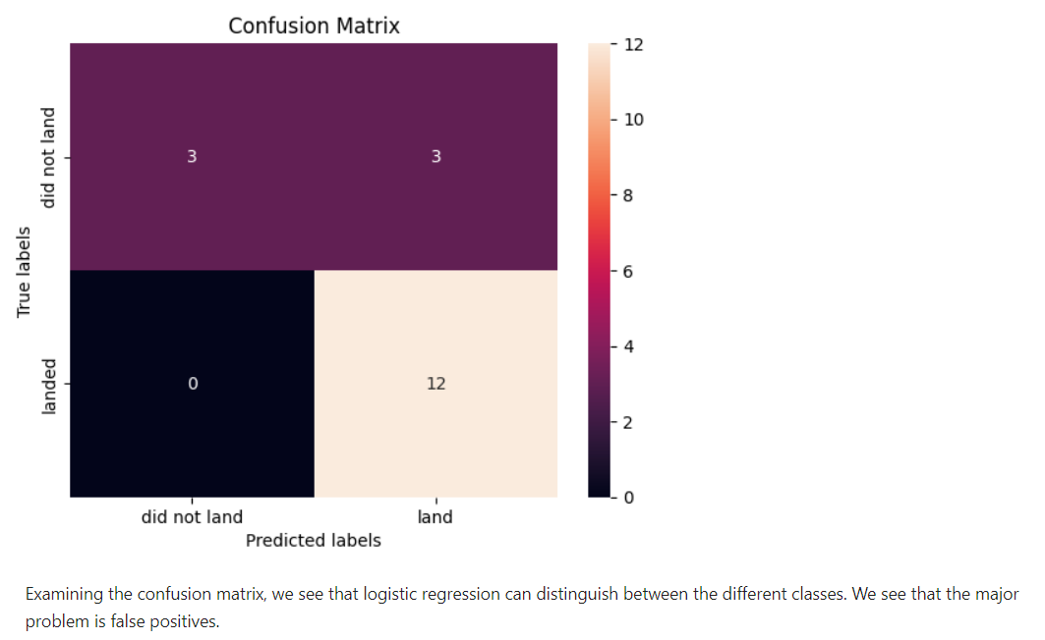
Results
Predictive Analysis:
After running each test, the results on the test data set were close.
The accuracy using the method .score() showed that they were all withing a very close accuracy range, not showing any significant percentage of error.

Slide 18

Section 2

Slide 19
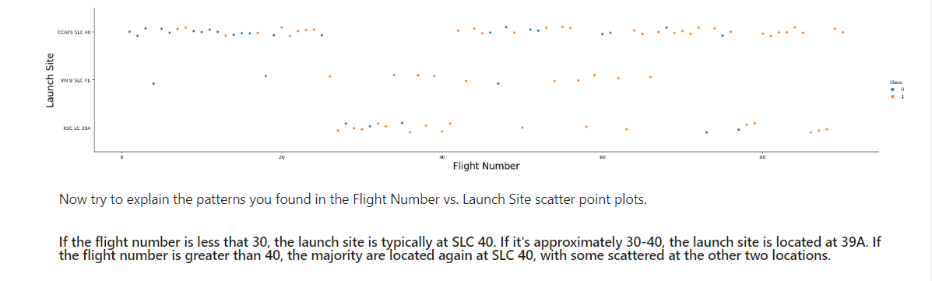
Flight Number vs. Launch Site
Source code:https://github.com/felicia-dobbins/Data_Science_Capstone/blob/main/IBM-DS0321EN-SkillsNetwork_labs_module_2_jupyter-labs-eda-dataviz.ipynb.jupyterlite%20(1).ipynb

Slide 20
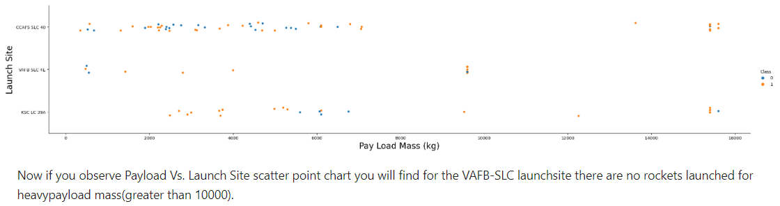
Payload vs. Launch Site
Source code:https://github.com/felicia-dobbins/Data_Science_Capstone/blob/main/IBM-DS0321EN-SkillsNetwork_labs_module_2_jupyter-labs-eda-dataviz.ipynb.jupyterlite%20(1).ipynb

Slide 21
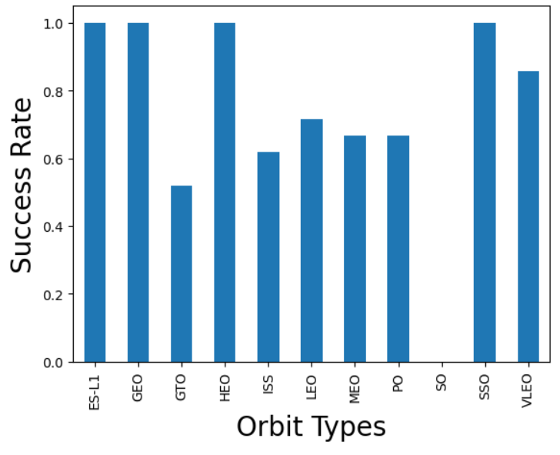
Success Rate vs. Orbit Type
Source code:https://github.com/felicia-dobbins/Data_Science_Capstone/blob/main/IBM-DS0321EN-SkillsNetwork_labs_module_2_jupyter-labs-eda-dataviz.ipynb.jupyterlite%20(1).ipynb

Slide 22
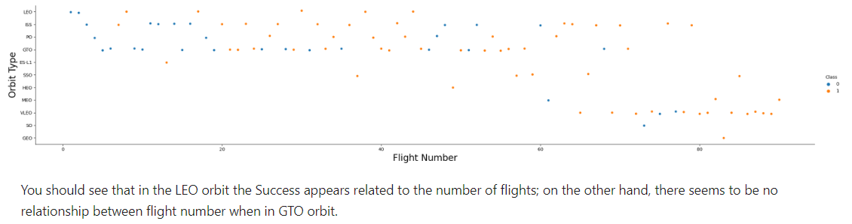
Flight Number vs. Orbit Type
Source code:https://github.com/felicia-dobbins/Data_Science_Capstone/blob/main/IBM-DS0321EN-SkillsNetwork_labs_module_2_jupyter-labs-eda-dataviz.ipynb.jupyterlite%20(1).ipynb

Slide 23
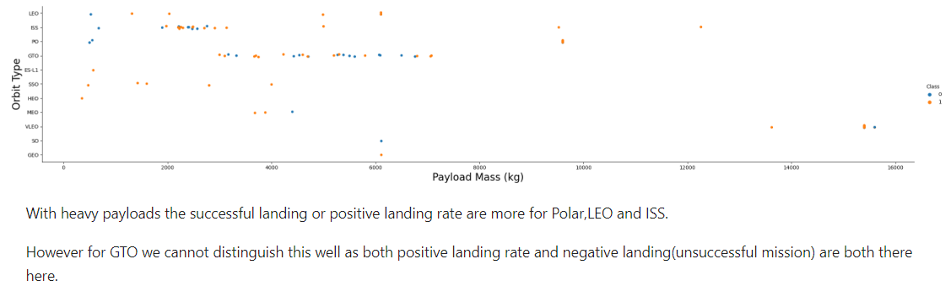
Payload vs. Orbit Type
Source code:https://github.com/felicia-dobbins/Data_Science_Capstone/blob/main/IBM-DS0321EN-SkillsNetwork_labs_module_2_jupyter-labs-eda-dataviz.ipynb.jupyterlite%20(1).ipynb

Slide 24
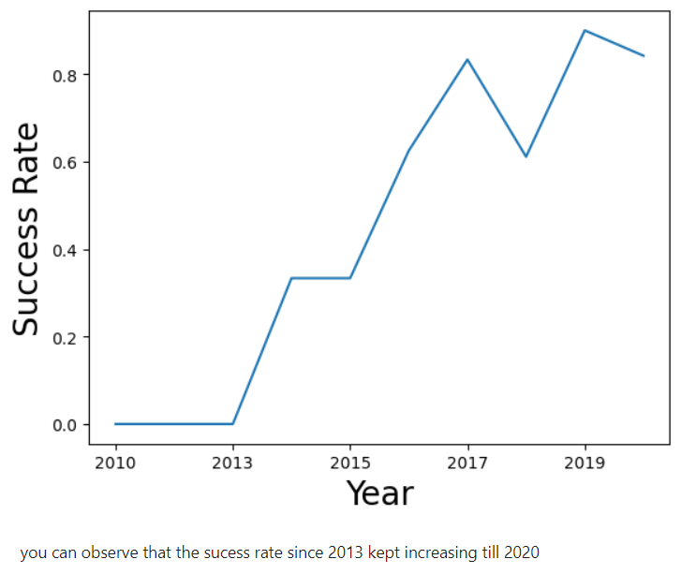
Launch Success Yearly Trend
Source code:https://github.com/felicia-dobbins/Data_Science_Capstone/blob/main/IBM-DS0321EN-SkillsNetwork_labs_module_2_jupyter-labs-eda-dataviz.ipynb.jupyterlite%20(1).ipynb

Slide 25
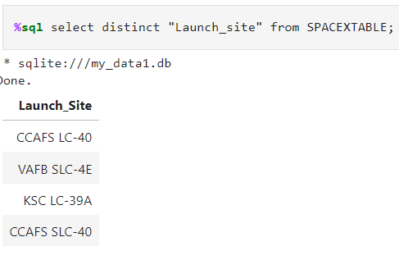
All Launch Site Names
Using SQL magic in Python3, I was able to use the ‘distinct’ function to identify all 4 names of the launch sites.
Source code:https://github.com/felicia-dobbins/Data_Science_Capstone/blob/main/EDA%20SQL.ipynb

Slide 26
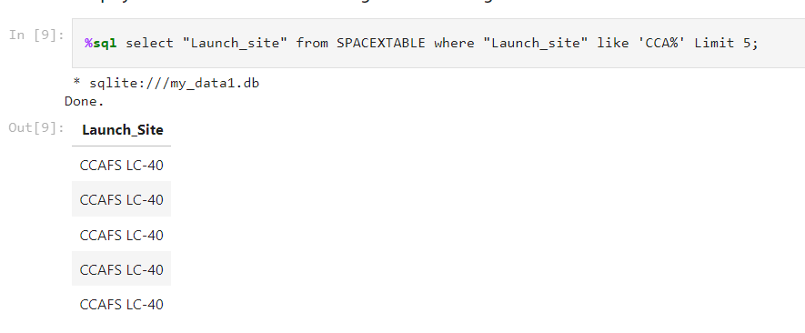
Launch Site Names Begin with 'CCA'
Source code:https://github.com/felicia-dobbins/Data_Science_Capstone/blob/main/EDA%20SQL.ipynb

Slide 27
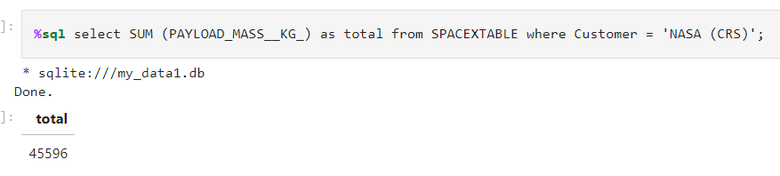
Total Payload Mass
Results show that the sum of the Payload Mass from NASA was 45,596 Kg.
Source code:https://github.com/felicia-dobbins/Data_Science_Capstone/blob/main/EDA%20SQL.ipynb

Slide 28
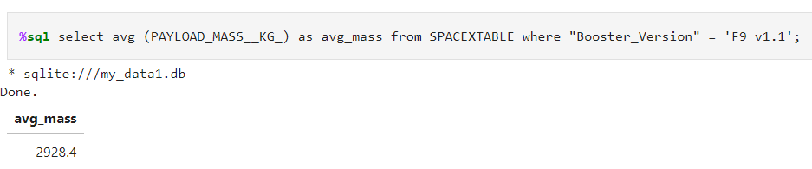
Average Payload Mass by F9 v1.1
The average Payload Mass in Kg of booster version F9 v1.1 was 2928.4 Kg.
Source code:https://github.com/felicia-dobbins/Data_Science_Capstone/blob/main/EDA%20SQL.ipynb

Slide 29
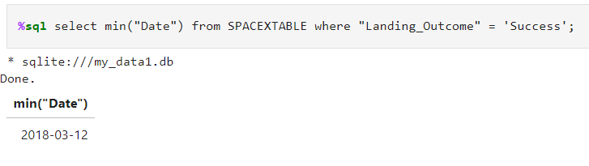
First Successful Ground Landing Date
The first successful ground landing took place on March 12, 2018.
Source code:https://github.com/felicia-dobbins/Data_Science_Capstone/blob/main/EDA%20SQL.ipynb

Slide 30
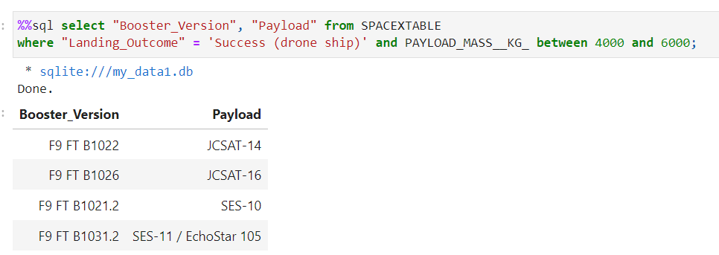
Successful Drone Ship Landing with Payload between 4000 and 6000
The table shows 4 models and their payloads between 4000 and 6000 Kg that had successful drone ship landings.
Source code:https://github.com/felicia-dobbins/Data_Science_Capstone/blob/main/EDA%20SQL.ipynb

Slide 31
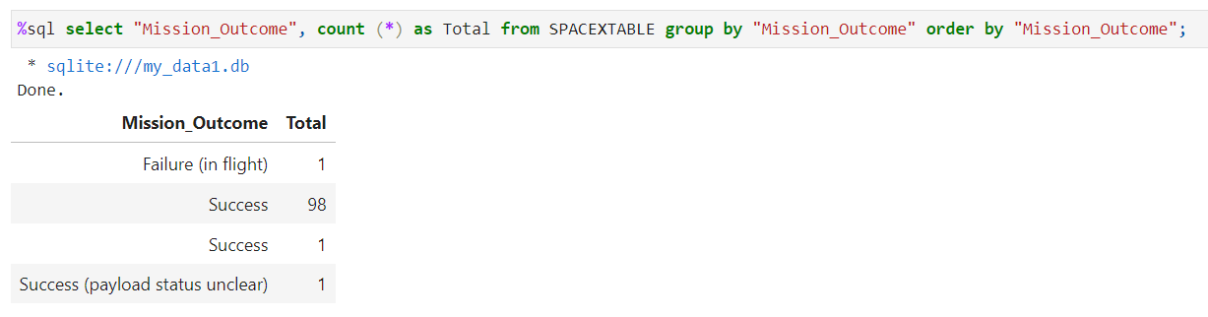
Total Number of Successful and Failure Mission Outcomes
The chart shows the overwhelming number of successful mission outcomes.
Source code:https://github.com/felicia-dobbins/Data_Science_Capstone/blob/main/EDA%20SQL.ipynb

Slide 32
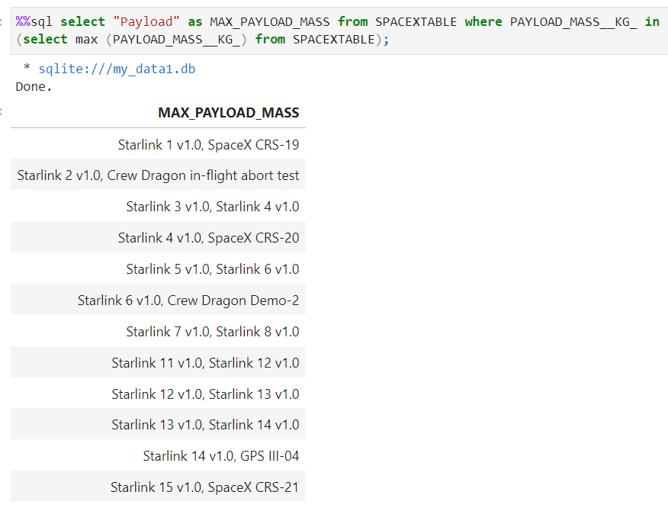
Boosters Carried Maximum Payload
The chart shows the booster models that have carried the maximum payload.
Source code:https://github.com/felicia-dobbins/Data_Science_Capstone/blob/main/EDA%20SQL.ipynb

Slide 33
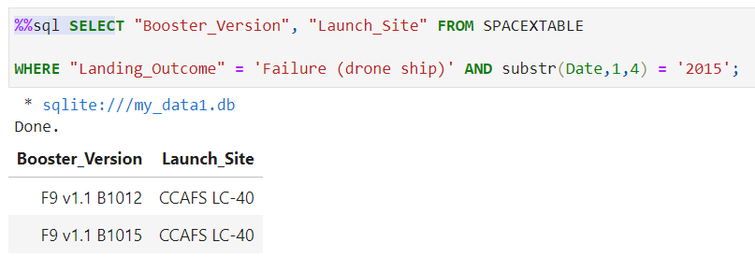
2015 Launch Records
The query above show two failed drone ship landing outcomes in 2015.
Source code:https://github.com/felicia-dobbins/Data_Science_Capstone/blob/main/EDA%20SQL.ipynb

Slide 34
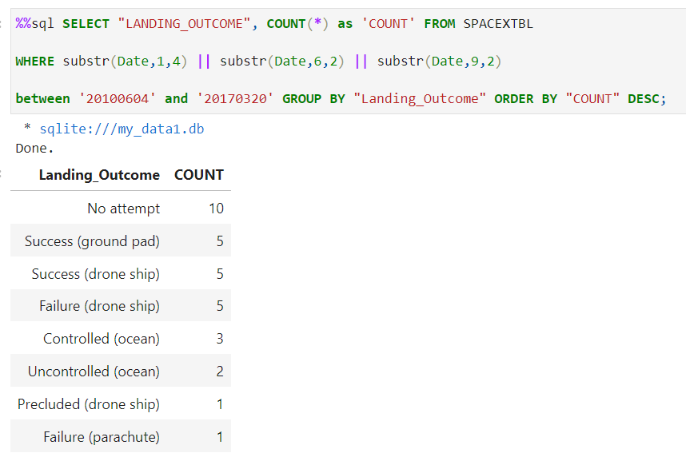
Rank Landing Outcomes Between 2010-06-04 and 2017-03-20
The chart to the left shows the number of landing outcomes from greatest to least between June 4th, 2010 and March 20th, 2017.
Source code:https://github.com/felicia-dobbins/Data_Science_Capstone/blob/main/EDA%20SQL.ipynb

Slide 35

Section 3

Slide 36
Global Launch Sites- SpaceX
3 out of 4 locations are on the east coast in Florida, the other located in California.
All sites are at coastal locations, likely for safety reasons.
Most launches take place in Florida.

Slide 37
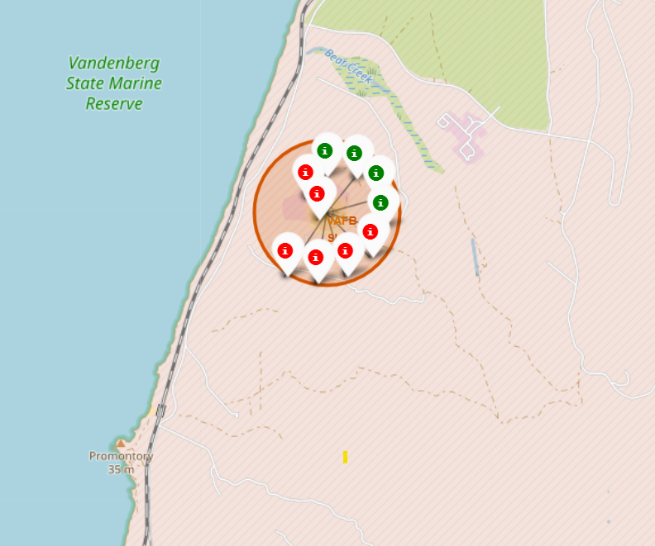
Launch Site- California
Important features:
Notice the spiral pattern of each site.
Green represents a successful launch, red an unsuccessful launch.
The successful launches are to the north, while unsuccessful are more to the south.
There are no nearby towns, large infrastructure, or populations.
Source code: https://github.com/felicia-dobbins/Data_Science_Capstone/blob/main/Location%20Analysis%20with%20Folium.ipynb

Slide 38
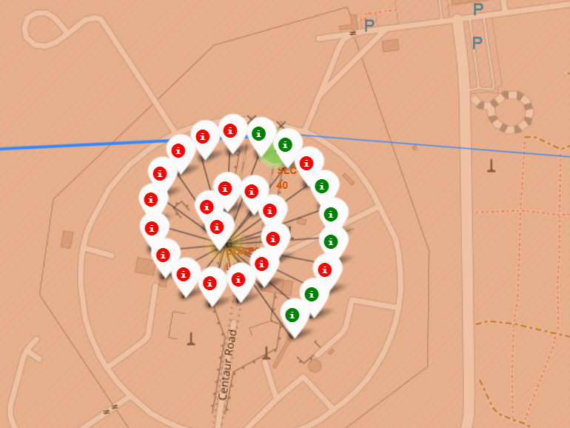
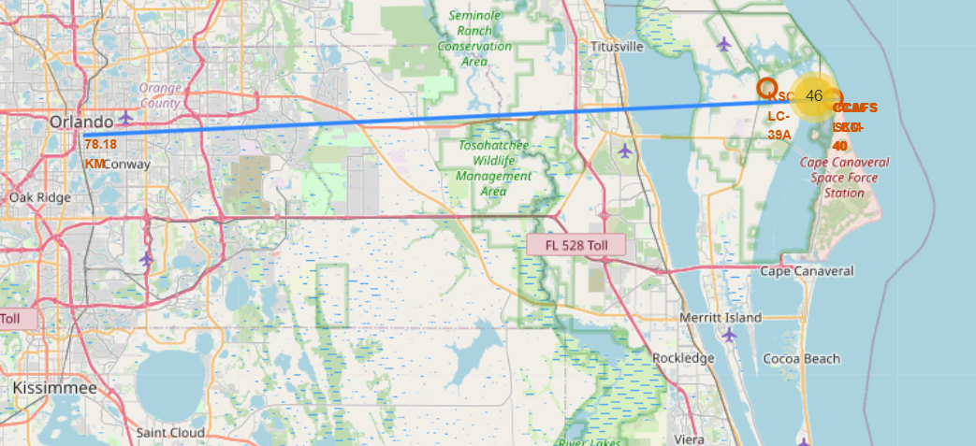
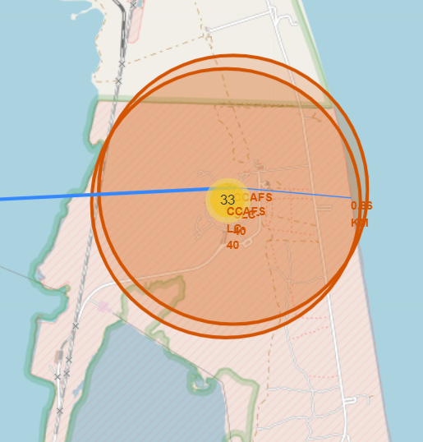
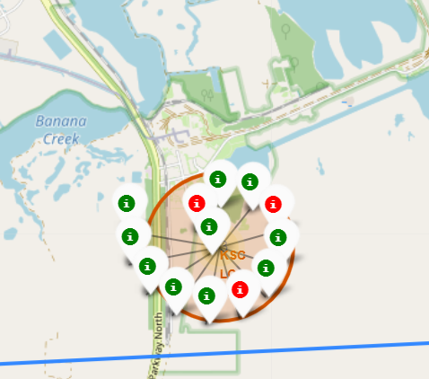
Launch sites- Florida
Compared to the site in California, Florida is much closer to more densely populated areas and has had much more launch activity.
Source code: https://github.com/felicia-dobbins/Data_Science_Capstone/blob/main/Location%20Analysis%20with%20Folium.ipynb

Slide 39

Section 4

Slide 40
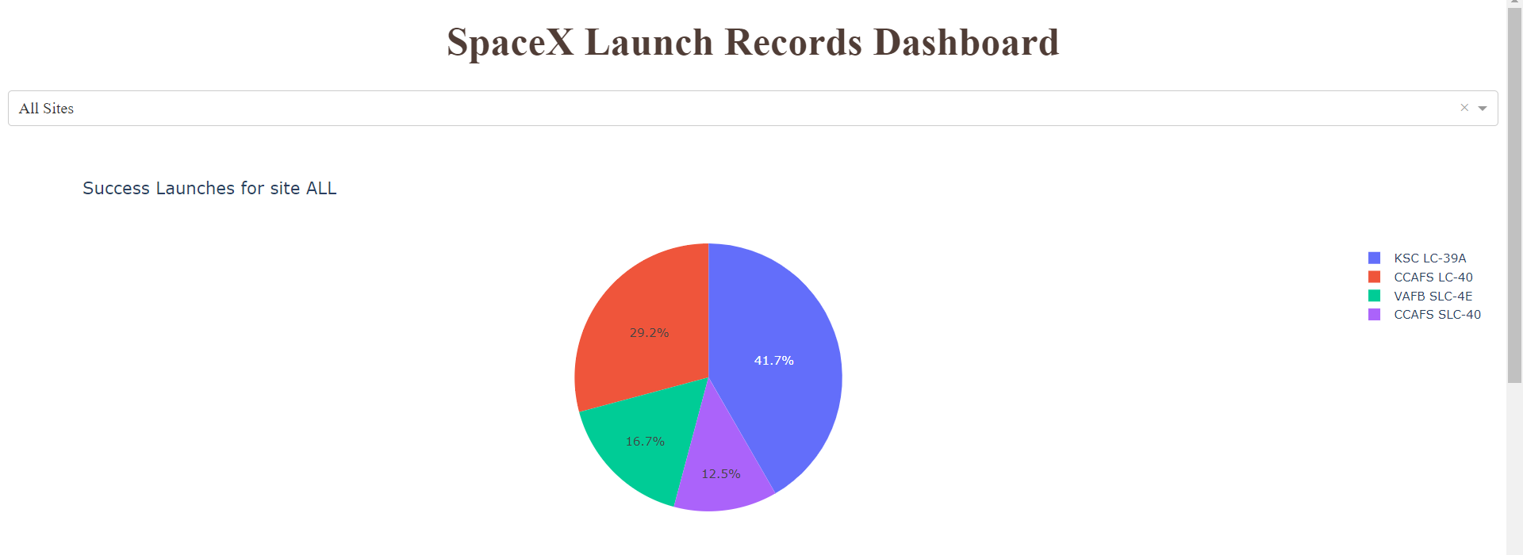
Percentage of Successful Launches for All Sites
Site KSC LC-39A has had the greatest number of successful launches.
Site CCAFS SLC-40 has had the least number of successful launches.
Source code: https://github.com/felicia-dobbins/Data_Science_Capstone/blob/main/spacex_dash_app%20(1).py

Slide 41
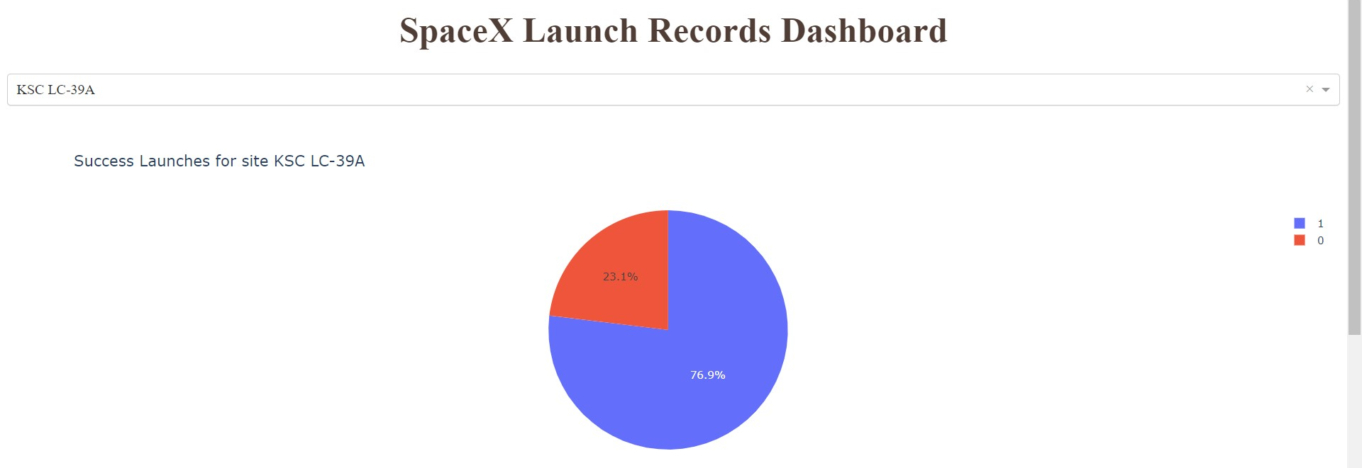
Launch Site with Highest Launch Success Ratio
Source code: https://github.com/felicia-dobbins/Data_Science_Capstone/blob/main/spacex_dash_app%20(1).py

Slide 42
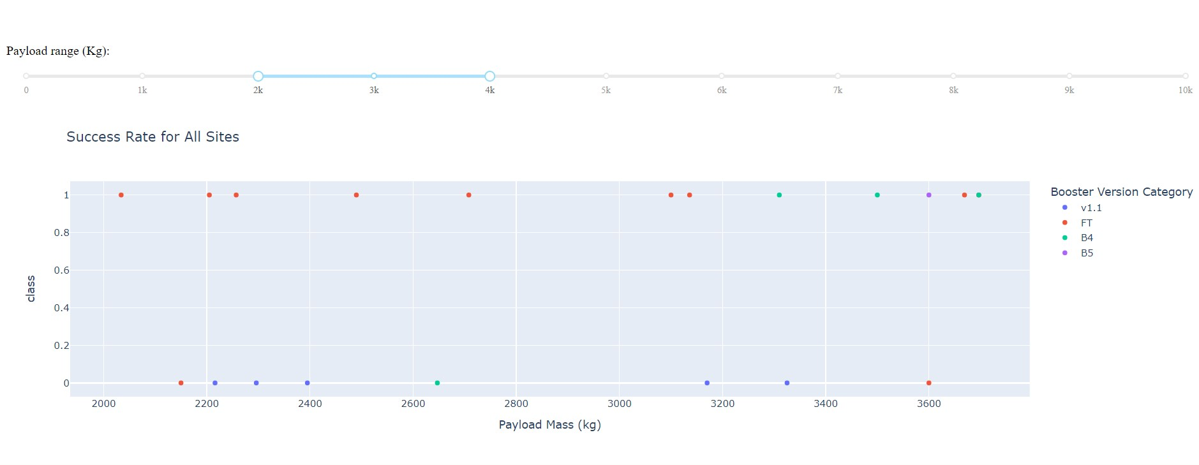
Source code: https://github.com/felicia-dobbins/Data_Science_Capstone/blob/main/spacex_dash_app%20(1).py
Payload vs. Launch Outcome
By restricting the payload range, we can see how the success rate for each model increases or decreases. For example, the image shows the payload range between 2000 kg and 4000 kg, and the Booster Version FT show a rate of success for this range. However, once this range increases, this success decreases. The key is to optimize the payload and the booster version for the highest chance at success.

Slide 43

Section 5

Slide 44
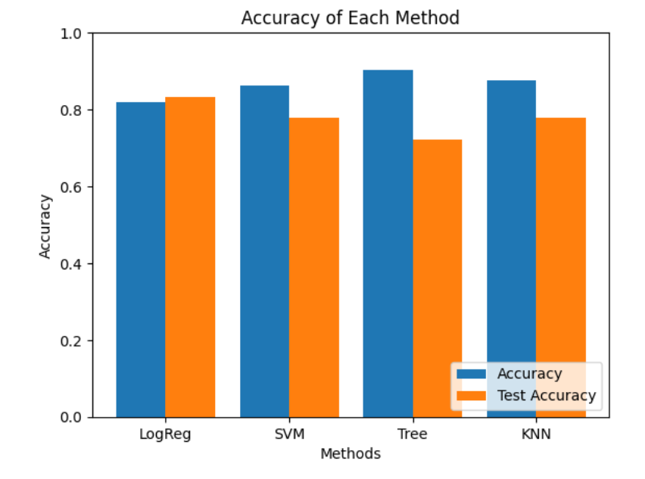
Classification Accuracy
Decision tree method has the highest predicted accuracy, but the lowest test accuracy.
Logistic Regression has the highest test accuracy of all the tests, but the margin of error was not great for either of them.
Source code: https://github.com/felicia-dobbins/Data_Science_Capstone/blob/main/spacex_dash_app%20(1).py

Slide 45
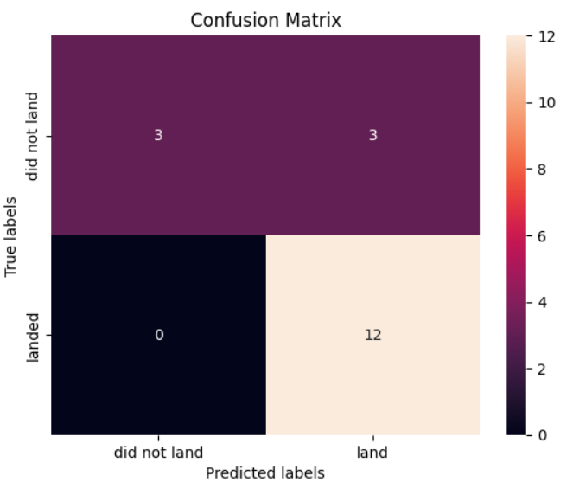
Confusion Matrix- Logistic Regression
This is the confusion matrix for logistic regression which was the highest test accuracy of the prediction tests. The confusion matrix shows an issue with false positives: a prediction that a launch will not land but does.
Source code: https://github.com/felicia-dobbins/Data_Science_Capstone/blob/main/spacex_dash_app%20(1).py

Slide 46
Conclusions
Different data sources were analyzed, data was explored, and tests were performed
All launch sites are in coastal locations likely due to safety concerns.
Mission success does not equate to launch success as some missions are intended to be failures for training or other purposes. Mission success rate is nearly 100%
Rocket Booster Versions continue to improve as time advances and technology improves.
Some Booster Versions have better success rates at certain payload mass ranges, while others perform better in heavier ranges. Booster Versions should be carefully selected depending on the payload mass carried.
Given that the mission success rate is nearly 100%, meaning intended mission outcomes are achieved, I believe it is accurate to say that SpaceX’s claim of cost is true.

Slide 47
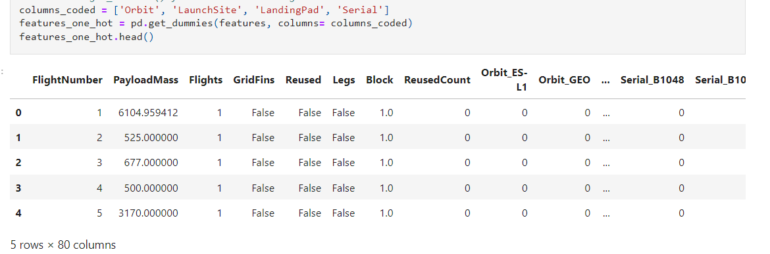
Appendix
Used ‘One Hot Encoding’ to create dummy variables to assign to categorical columns

Slide 48


